Slide 1

Smart Streetlight
Proof of Concept
Thor Cutler
Tucker Russ
Anthony Giordano
Brandon Berry
Group 9
11/20/15

Slide 2
Overview
Group 9
Tucker
Introduction
Current Problem/Future Solution
XBee Communication
Streetlight XBee Device
User Interface XBee Device
LED Lighting Specifications
DC Power Supply Specifications
Backup Battery Details
Streetlight Distances

Slide 3
Introduction
Group 9
Tucker
Fully working Smart Streetlight System Demo Model
Give exposure to new Smart Grid Technology
Build design using our design and programs
Minimum of two Streetlights, potential Smart Meter and a User Interface Device
Show advantages of implementing Street Lights on our Campus

Slide 4

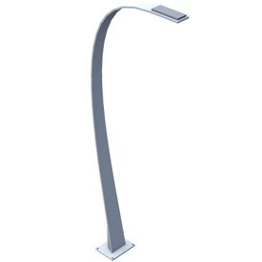



Todays Scenario (Problem)
Group 9
Tucker
When a Streetlight, House, or Campus Building looses power
The only way the utility company knows of the outage is if a customer calls in to report the outage and the its location

Slide 5
How to solve this problem?
Group 9
Tucker
Supply the utility with outage information:
  Exact time of the outage
  Location of the outage
  How many devices were effected

Slide 6
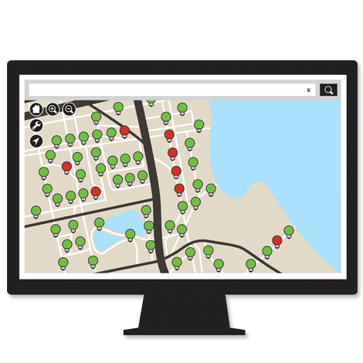
Smart Streetlight System Scenario
Group 9
Tucker
When a Streetlight, House, or Campus Building looses power
The utility company is immediately notified of the outage and the location through the User Interface
Notes:
This allows them to not only know the exact time of the outage but also if other devices are effected (Ill talk more about that) and the exact location so they can pinpoint the problem which leads to less troubleshooting

Slide 7
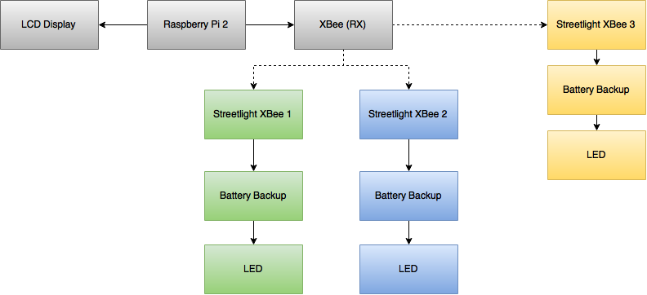
Top-level Hardware Design
Group 9
Tucker

Slide 8
System Requirements
Group 9
Thor
Requirement Code | Requirement Statement | Need Mapping | Explanation
R_S1 | The SSLS shall alert a user within 10 seconds of a monitored device losing power. | N_S1 N_S2 | The purpose of this requirement is to document one of the basic functions of our project. When a street light or smart meter loses power, the system user, by looking at the system’s monitor, will be alerted of the power loss.
R_S2 | The SSLS shall constantly show the status of all monitored devices, updating every 10 seconds. Status consists of: -Powered on or off -last updated -voltage -current -power | N_S3 N_S4 N_S8 N_Want1 N_Want3 N_want4 | The purpose of this requirement is to ensure that the system will constantly be updating data on a set time interval and not just when a monitored device loses power.
R_S3 | The SSLS shall receive status signals from monitored devices wirelessly. | N_S5 N_S6 N_S7 | The purpose of this requirement is to simulate that street lights are far enough apart that a wired connection isn’t practical
R_S4 | The SSLS shall be able to differentiate between different monitored devices by the signal that they send. | N_S7 | The purpose of this requirement is to ensure that each light sends a slightly different signal as to allow the user to know which light has lost power.

Slide 9
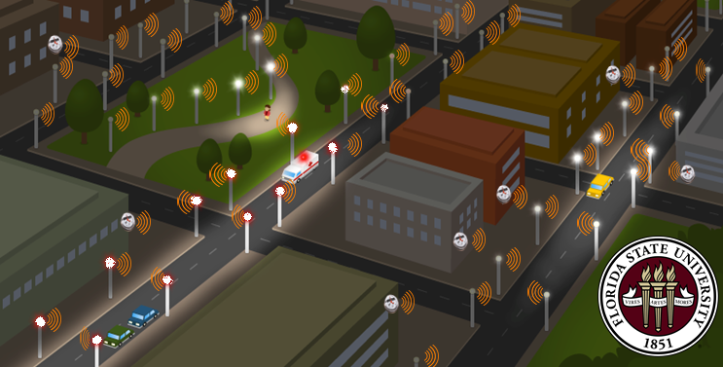
Mesh Network on Campus
Group 9
Tucker
Notes:
Each Streetlight now becomes a Node to the entire mesh network. The more streetlights the stronger the mesh network becomes. Now any Buildings can now be connected to these nodes by the Smart Meters on the building. This strengthens the mesh network and now brings the same functionality to buildings. With the number of streetlights on our campus this picture would be a good representation of Smart Streetlights being implemented on campus.

Slide 10
Benefits
Group 9
Tucker
Time since outage
Location of outage
More information leads to less troubleshooting to find where fault is located
Potential to do research, estimate costs of power saving ideas, etc.
Change existing streetlight bulbs to LEDs

Slide 11
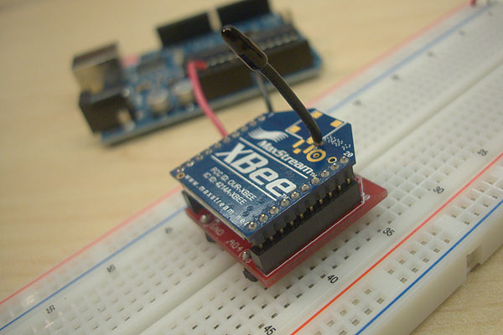
XBee Series 1
Group 9
Thor
2.4GHZ using IEEE 802.15.4
P2P and multi-point Mesh Network
3.3V, 50mA Input
300ft max outdoor range
1mW Output
6 10-bit ADC input pins
65536 Channels
Local or over-air configuration

Slide 12
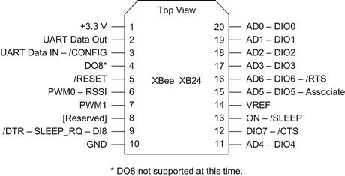
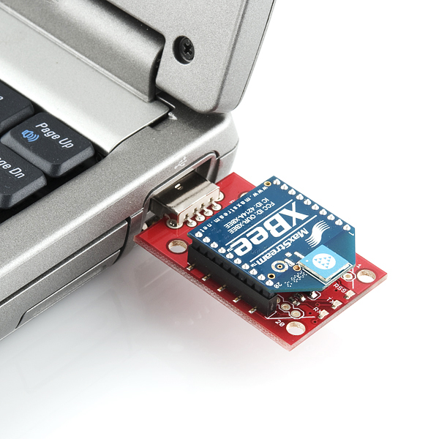
Configuration
Group 9
Thor
XBee devices are configured using X-CTU, a free multi-platform application by Digi
X-CTU allows each XBee device to be flashed with personal settings, such as using a certain pin as a digital input.

Slide 13
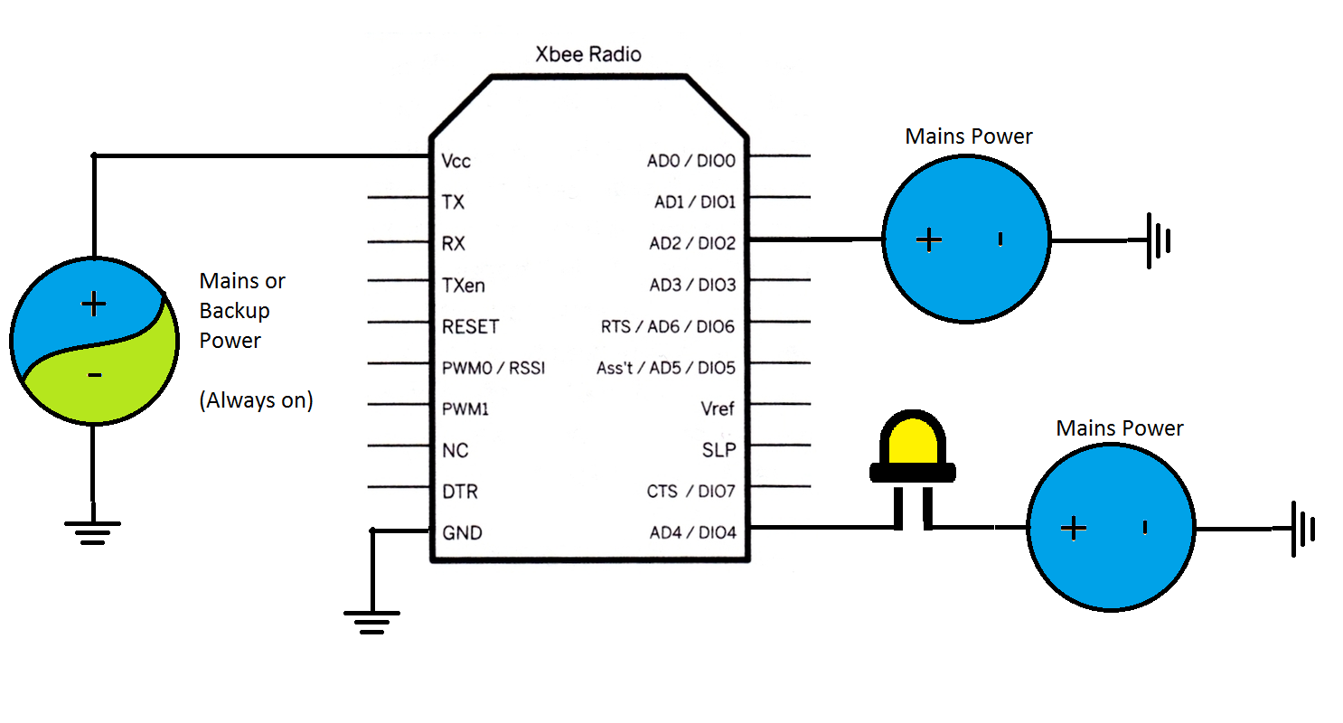
Streetlight XBee Device Design
Group 9
Thor

Slide 14
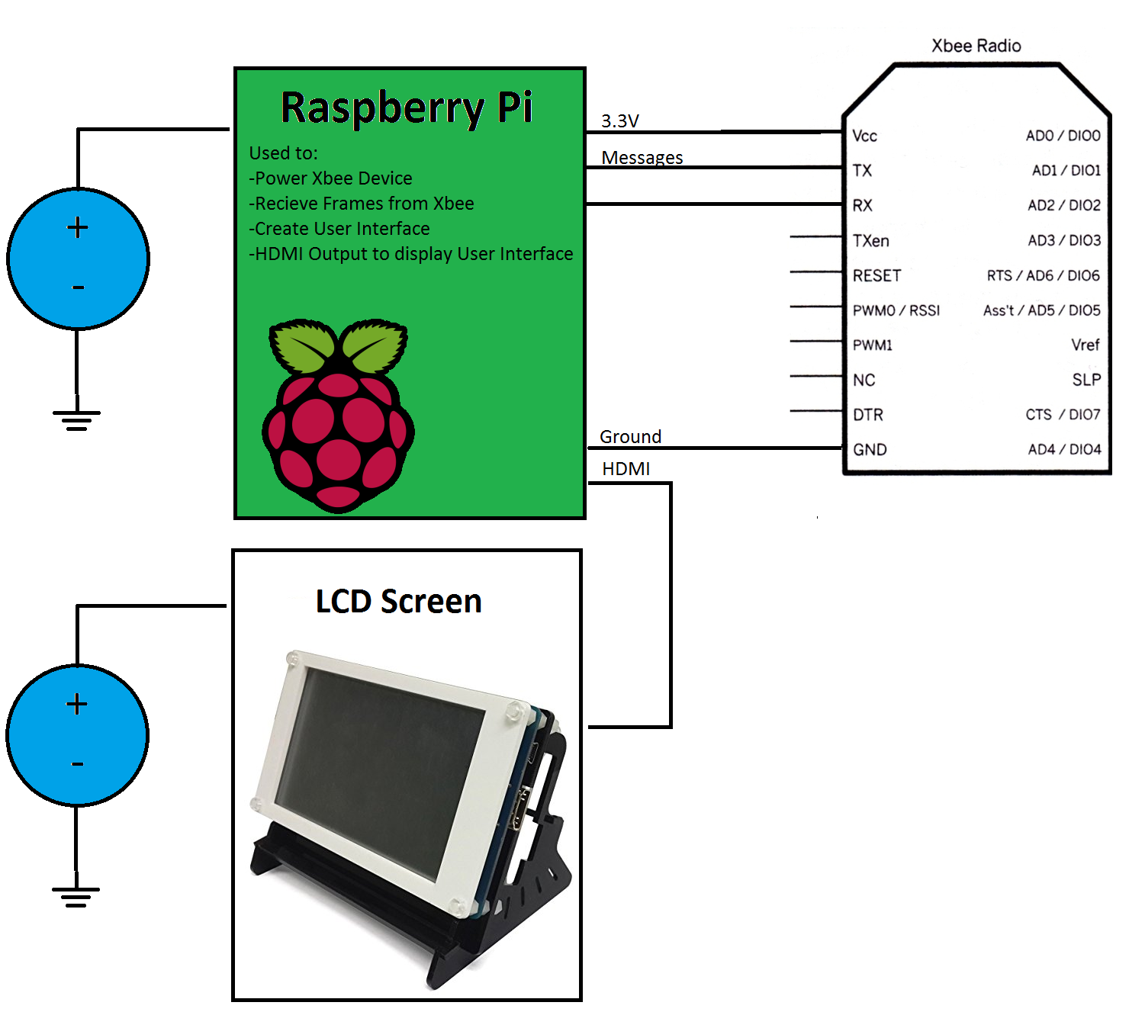
User Interface XBee Device Design
Group 9
Thor

Slide 15
Streetlight Xbee Device Properties
Group 9
Thor
The XBee device attached to a monitored device should always be powered, even if the monitored device is not
Send data packets (known as frames) on a set time intervals containing monitored device information
Uses two pins to monitor device allowing the data to show if the entire device has lost power, or if LED bulb is out

Slide 16
User Interface XBee Device Properties
Group 9
Thor
The Raspberry Pi will be connected to its own XBee device that is set up to receive data packets (frames) from the Xbee devices attached to monitored devices
The Raspberry Pi will use the data from the frames to determine the status of each monitored device
The status of each monitored device will be viewable on the LCD screen,

Slide 17
Data Packets (Frames) Explained
Group 9
Thor
7E, 0, 12, 92, 0, 13, A2, 0, 43, 78, FF, 79, 36, 6A, 1, 1, 0, 10, 0, 0, 10, CE
7E: Start Byte
0, 13, A2, 0, 43, 78, FF, 79: Source Address
0, 10: Digital Channel Mask
  1st byte (0) for D10, D11, D12; 2nd byte (10) for D0:D7
  Pin 4 is set to receive data
0, 10: Digital Sample Mask
  Basically means pin 4 is currently active high (Receiving Signal)
  If 4 becomes low, then becomes 0, 0

Slide 18
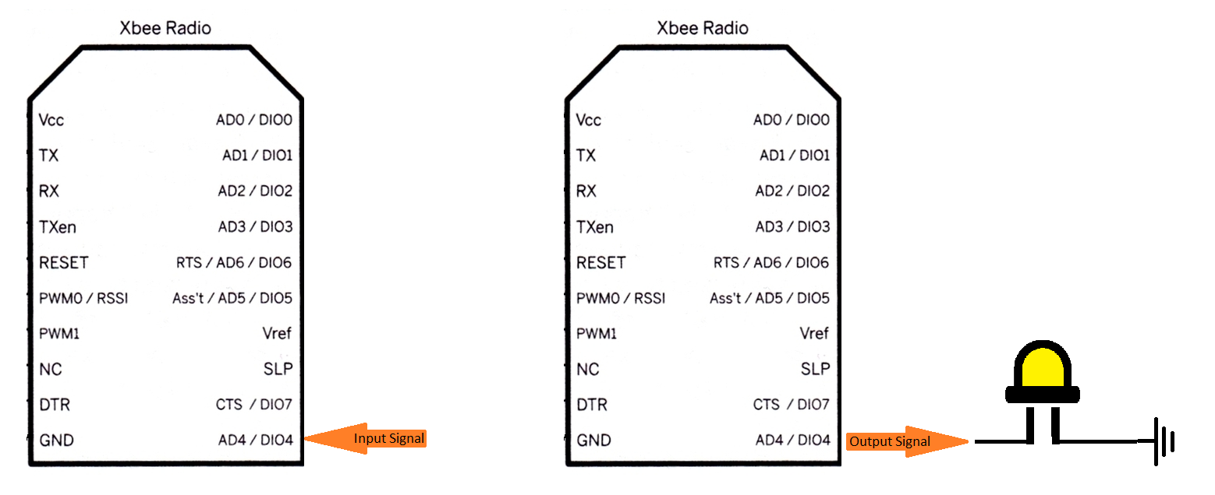
Demonstration
Group 9
Thor
Instead of sending a Frame, here we are using Line Passing
Line Passing emulates the input of a pin on one Xbee device as an output on the same pin on another Xbee device.

Slide 19

Model Design
Group 9
Brandon
Model will be on a mobile cart
Plexiglass will display electric components
Model buildings will represent buildings of a city or campus

Slide 20
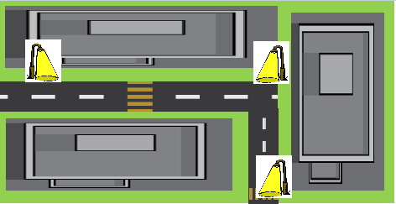
Building Layout
Group 9
Brandon

Slide 21
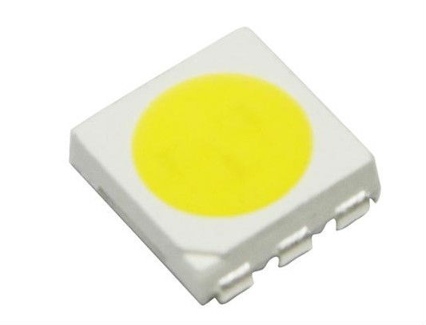
LEDs for Model
Group 9
Brandon
5050 SMD (Surface Mount Diode)
Dimensions: 5.0mm X 5.0mm
Power Draw: 60mA @ 2.8 - 3.4 Volts
Lumen Flux: 16-22 lumens

Slide 22
Street Light
Group 9
Brandon
3D Printed model street lights
XBee and LEDs will be built into the street light
They will be connected in parallel with the XBee connected to a backup battery

Slide 23
Why is a backup battery needed?
Group 9
Brandon
If the power supplied to the street light fails, the backup battery will provide enough power to allow the Xbee to still transmit for 50 hours
This lets us know when the power to a street light has gone out

Slide 24
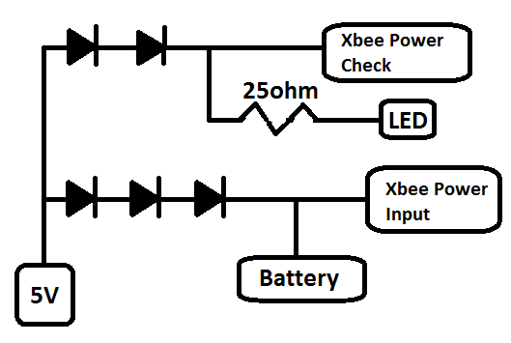
XBee & LED Circuit
Group 9
Brandon

Slide 25
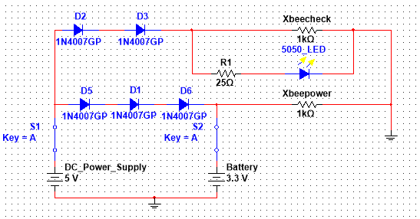
Power Schematic for XBee & LEDs
Group 9
Brandon

Slide 26
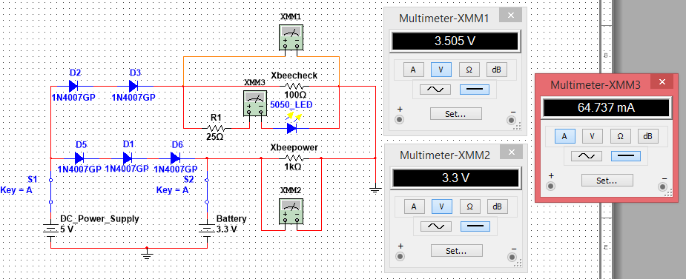
While DC Power is Connected
Group 9
Brandon

Slide 27
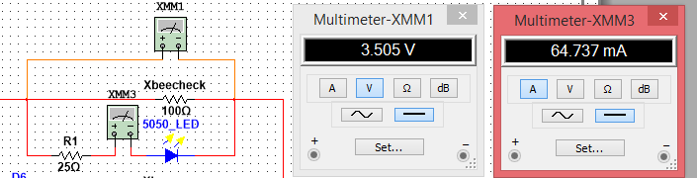
LED Input Current and Voltage
Group 9
Brandon

Slide 28
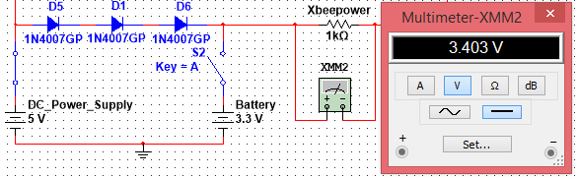
Battery and XBee Input Voltage
Group 9
Brandon
Three Diodes are used to reduce the voltage from 5 to 3.4 volts

Slide 29
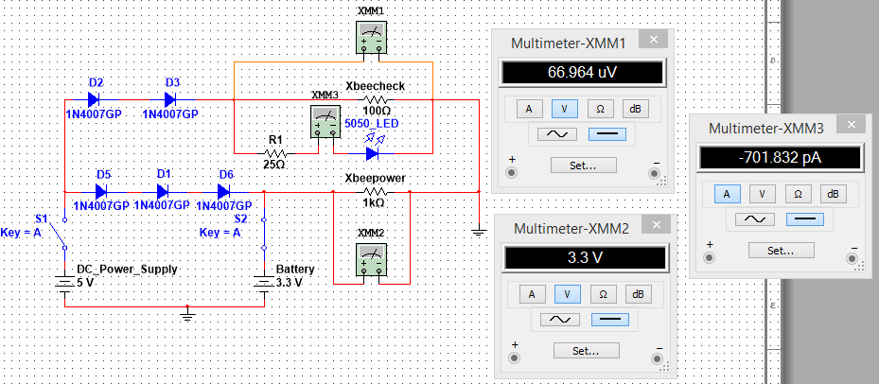
While DC Power is Disconnected
Group 9
Brandon
Diodes are used to prevent the backflow of current when the DC power supply goes down
This allows the XBeeCheck to see that the DC power supply has stopped working while the XBee itself still receives power

Slide 30
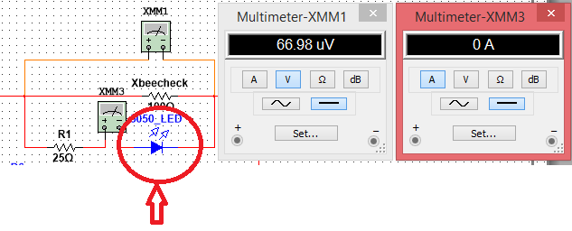
LED is off when the DC Power goes down
Group 9
Brandon

Slide 31
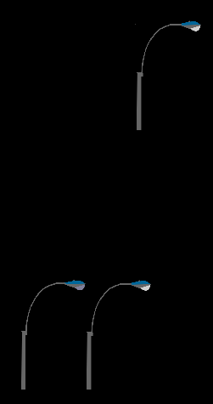
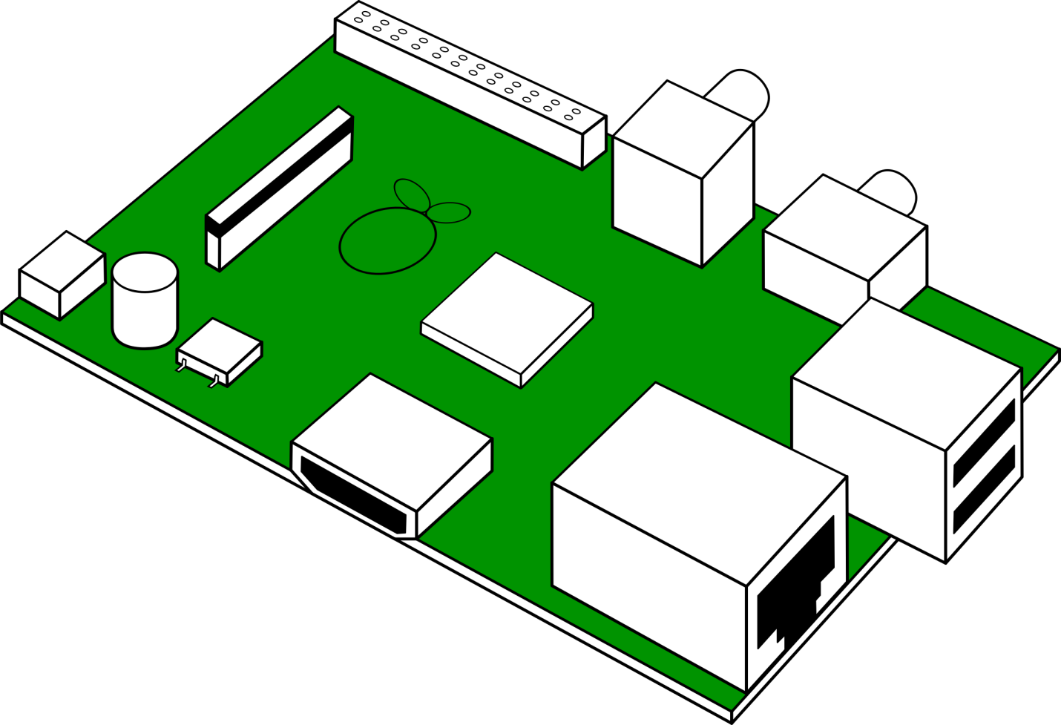
What Will Be Powered?
Group 9
Anthony
3 XBee: 3.3V each 50mA
3 LEDs: 2.8-3.4V, 60mA-80mA
                -Two on cart
            -One far away
Raspberry Pi 2: Running at 5V

Slide 32
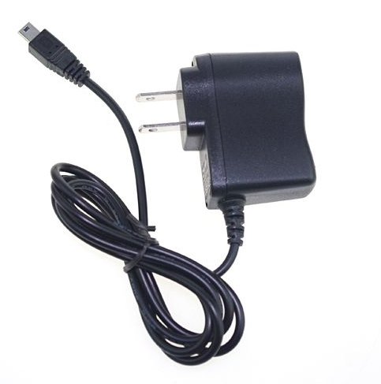

Power Supply
Group 9
Anthony
Three 5 Volt 1 Amp DC power supplies
Individual power source per streetlight in order to recognize which power source is out

Slide 33
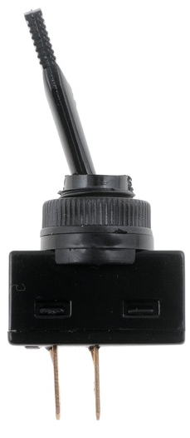

Toggle Switches
Group 9
Anthony
1 switch per Streetlight (3 total)
1 switch for Smart Meter
1 Main Turn Off switch

Slide 34
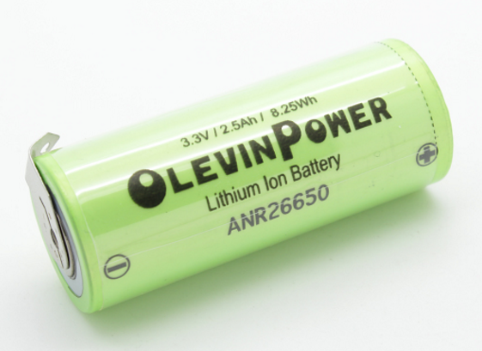
Lithium Ion Battery
Group 9
Anthony
Chemistry: Lithium Ion
Output Voltage: 3.3V
Current: 50mA
Capacity: 2500 mAh
Time: 50 hours

Slide 35
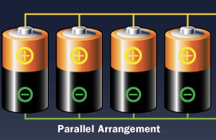
Battery Configuration
Group 9
Anthony
Batteries will be connected in parallel in order to produce power for a longer period of time
Capacity
Current
Time =

Slide 36
Power Layout
Group 9
Anthony
Smart Meter
w/XBee
LED
120V
5V DC
5V
Streetlight 1
5V DC
5V
Streetlight 2
120 V
5V DC
5V
Raspberry Pi
5V DC
5V
Streetlight 3
120 V

Slide 37
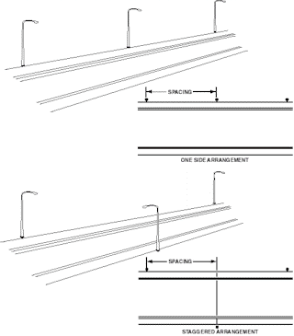
Typical Streetlight Ranges
Group 9
Anthony
Opposite orientation:
Space between: 50 feet
Height from ground: 13 feet
Staggered orientation:
Space between: 125 – 150 feet
Height from ground: 25 – 40 feet

Slide 38
XBee Options
Group 9
Anthony
Device | Xbee series 1 | XBee-Pro | XBee Series 2.5
Indoor range | 100 ft | 300 ft | 133 ft
Outdoor range | 300 ft | 1 mile | 400 ft
Transmit power | 1mW | 63mW | 1.25 mW
Receiver sensitivity | -92 dBm | -100 dBm | -96 dBm
Supply voltage | 2.8-3.4 V | 2.8-3.4 V | 2.1-3.6
Transmit current | 45 mA (@3.3V) | 250 mA (@3.3V) | 40 mA (@3.3V)
Receive current | 50 mA (3.3V) | 55 mA (3.3V) | 35 mA (@3.3V)
Power down current | < 10 uA | <10 uA | < 1 uA
Operating frequency | 2.4 GHz | 2.4 GHz | 2.4 GHz
Operating temperature | -40 to 85 Deg C | -40 to 85 Deg C | -40 to 85 Deg C

Slide 39
Questions?
Group 9

Slide 40
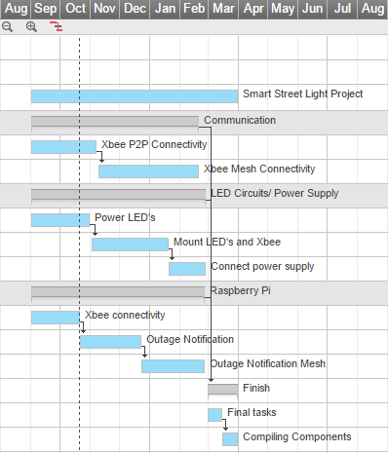
Group 9

